Slide 1
GRYVEYARDS
GAME MUSIC REFERENCES

Slide 2
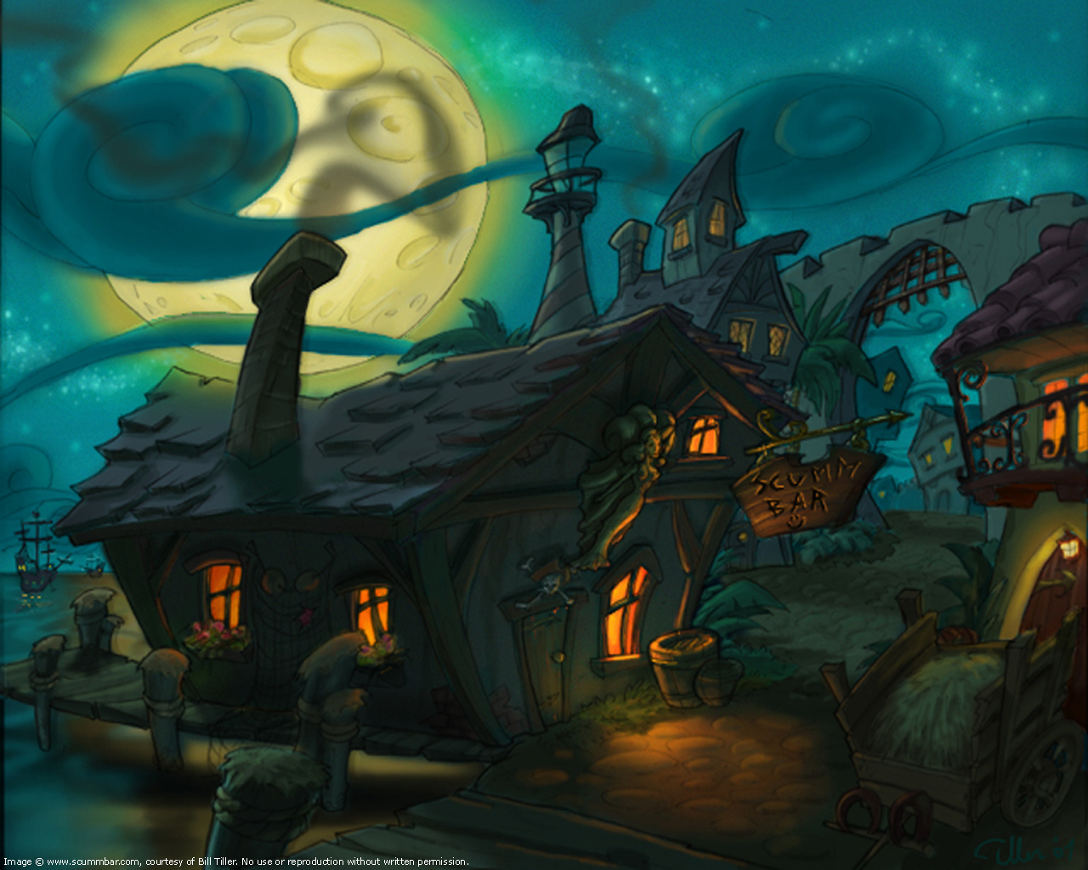
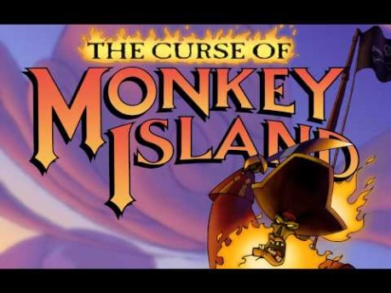
REFERENCE The Curse of Monkey Island
Things that might be useful towards the project:
Harpsichord
Plucked cello & bass.
Vocal background drone.
Glockenspiel.
Sad, dark patterns.

Slide 3
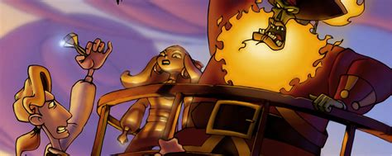
REFERENCE The Curse of Monkey Island
Things that might be useful towards the project:
Bassoon.
Bass Clarinet
Rhythmic music.
Melody driven.

Slide 4
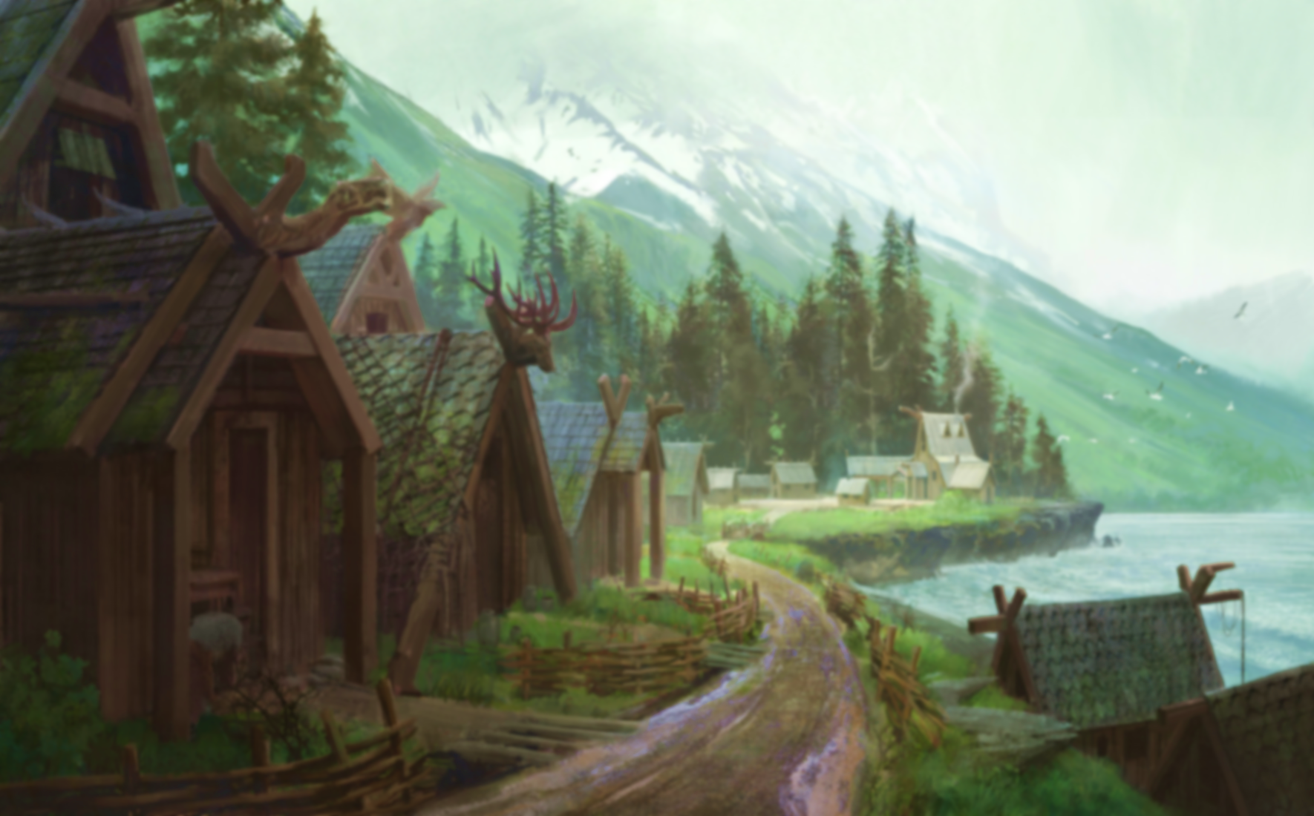
GAME PITCH
Key elements to take from previous references:
Supporting orchestral string section.*
Slow attack/release warm ambient pads and drones.
Flute-like synths.
Very long reverbs.
Acoustic and reversed guitars.*
*Some of these elements are missing from the music pitch.

